Slide 1
Lecture No. 16
Digital Logic & Design
COMPARATOR

Slide 2
Comparator Circuit
Inputs two 2-bit binary numbers A and B
Has three outputs
A>B
A=B
A<B

Slide 3
Function Table for A>B
Inputs |  |  |  | Output
A₁ | A₀ | B₁ | B₀ | A>B
0 | 0 | 0 | 0 | 0
0 | 0 | 0 | 1 | 0
0 | 0 | 1 | 0 | 0
0 | 0 | 1 | 1 | 0
0 | 1 | 0 | 0 | 1
0 | 1 | 0 | 1 | 0
0 | 1 | 1 | 0 | 0
0 | 1 | 1 | 1 | 0
Inputs |  |  |  | Output
A₁ | A₀ | B₁ | B₀ | A>B
1 | 0 | 0 | 0 | 1
1 | 0 | 0 | 1 | 1
1 | 0 | 1 | 0 | 0
1 | 0 | 1 | 1 | 0
1 | 1 | 0 | 0 | 1
1 | 1 | 0 | 1 | 1
1 | 1 | 1 | 0 | 1
1 | 1 | 1 | 1 | 0
Notes:
The function table for the output A>B represents the output of the circuit output logic line representing A>B for 16 combinations of the 2-bit numbers A and B.
The input numbers A and B are represented by A₁A₀ and B₁B₀ columns of the function table
Output A>B line is set to 1 when A>B.
Thus for input combinations of A and B that is 01 00, 10 00, 10 01, 11 00, 11 01 and 11 10 the output A>B is 1

Slide 4
Function Table for A=B
Inputs |  |  |  | Output
A₁ | A₀ | B₁ | B₀ | A=B
0 | 0 | 0 | 0 | 1
0 | 0 | 0 | 1 | 0
0 | 0 | 1 | 0 | 0
0 | 0 | 1 | 1 | 0
0 | 1 | 0 | 0 | 0
0 | 1 | 0 | 1 | 1
0 | 1 | 1 | 0 | 0
0 | 1 | 1 | 1 | 0
Inputs |  |  |  | Output
A₁ | A₀ | B₁ | B₀ | A=B
1 | 0 | 0 | 0 | 0
1 | 0 | 0 | 1 | 0
1 | 0 | 1 | 0 | 1
1 | 0 | 1 | 1 | 0
1 | 1 | 0 | 0 | 0
1 | 1 | 0 | 1 | 0
1 | 1 | 1 | 0 | 0
1 | 1 | 1 | 1 | 1
Notes:
The function table for the output A=B represents the output of the circuit logic line representing A=B for 16 combinations of the 2-bit numbers A and B.
The input numbers A and B are represented by A₁A₀ and B₁B₀ columns of the function table
Output A=B line is set to 1 when A=B.
Thus for input combinations of A and B that is 00 00, 01 01, 10 10 and 11 11 the output A=B is 1

Slide 5
Function Table for A<B
Inputs |  |  |  | Output
A₁ | A₀ | B₁ | B₀ | A<B
0 | 0 | 0 | 0 | 0
0 | 0 | 0 | 1 | 1
0 | 0 | 1 | 0 | 1
0 | 0 | 1 | 1 | 1
0 | 1 | 0 | 0 | 0
0 | 1 | 0 | 1 | 0
0 | 1 | 1 | 0 | 1
0 | 1 | 1 | 1 | 1
Inputs |  |  |  | Output
A₁ | A₀ | B₁ | B₀ | A<B
1 | 0 | 0 | 0 | 0
1 | 0 | 0 | 1 | 0
1 | 0 | 1 | 0 | 0
1 | 0 | 1 | 1 | 1
1 | 1 | 0 | 0 | 0
1 | 1 | 0 | 1 | 0
1 | 1 | 1 | 0 | 0
1 | 1 | 1 | 1 | 0
Notes:
The function table for the output A<B represents the output of the circuit logic line representing A<B for 16 combinations of the 2-bit numbers A and B.
The input numbers A and B are represented by A₁A₀ and B₁B₀ columns of the function table
Output A<B line is set to 1 when A<B.
Thus for input combinations of A and B that is 00 01, 00 10, 00 11, 01 10, 01 11 and 10 11 the output A<B is 1

Slide 6
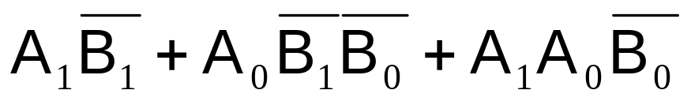
Karnaugh Map for A>B
A₁A₀/ B₁B₀ | 00 | 01 | 11 | 10
00 | 0 | 0 | 0 | 0
01 | 1 | 0 | 0 | 0
11 | 1 | 1 | 0 | 1
10 | 1 | 1 | 0 | 0
Notes:
Simplifying expression for A>B through a 4-variable K-map yields A1B1*+A0B1*B0*+A1A0B0*
Note that the left most column has binary values 00, 01, 11 and 10 representing A1A0
The top row has binary values 00, 01, 11 and 10 representing B1B0

Slide 7
Karnaugh Map for A=B
A₁A₀/ B₁B₀ | 00 | 01 | 11 | 10
00 | 1 | 0 | 0 | 0
01 | 0 | 1 | 0 | 0
11 | 0 | 0 | 1 | 0
10 | 0 | 0 | 0 | 1
Notes:
Simplifying expression for A=B through a 4-variable K-map yields A1*A0*B1*B0*+A1*A0B1*B0+A1A0B1B0+A1A0*B1B0*

Slide 8
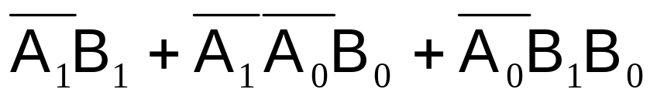
Karnaugh Map for A<B
A₁A₀/ B₁B₀ | 00 | 01 | 11 | 10
00 | 0 | 1 | 1 | 1
01 | 0 | 0 | 1 | 1
11 | 0 | 0 | 0 | 0
10 | 0 | 0 | 1 | 0
Notes:
Simplifying expression for A<B through a 4-variable K-map yields A1*B1+A1*A0*B0+A0*B1B0

Slide 9
Parallel Comparators

Slide 10
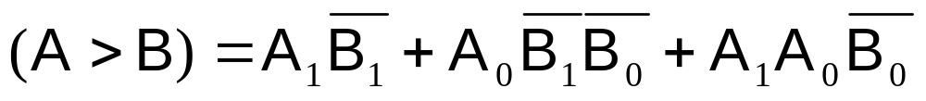
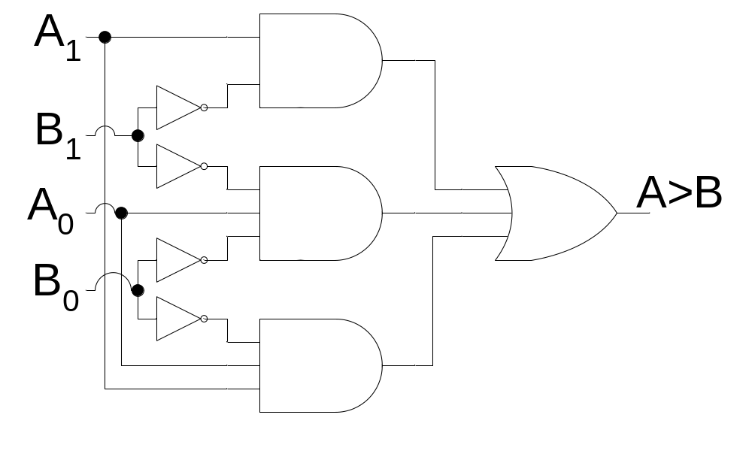
Implementation of A>B

Slide 11
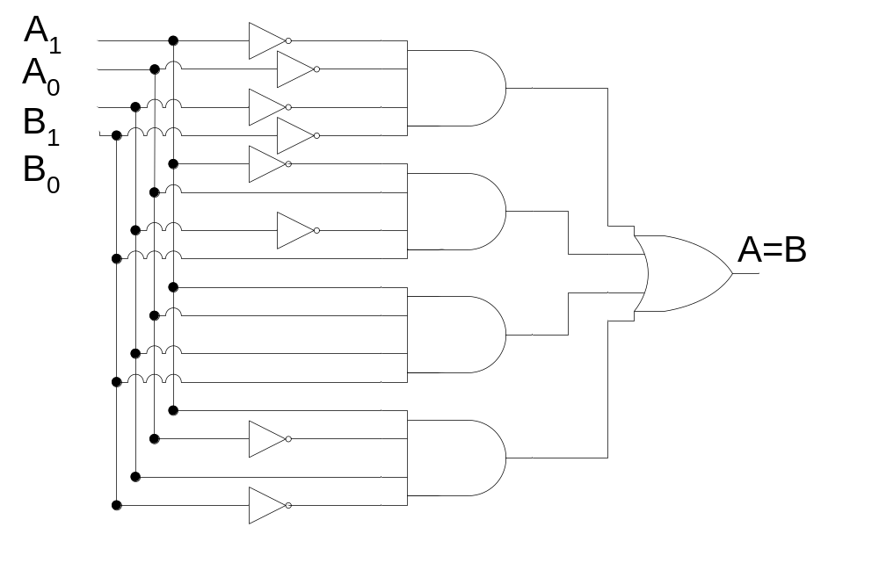
Implementation of A=B

Slide 12
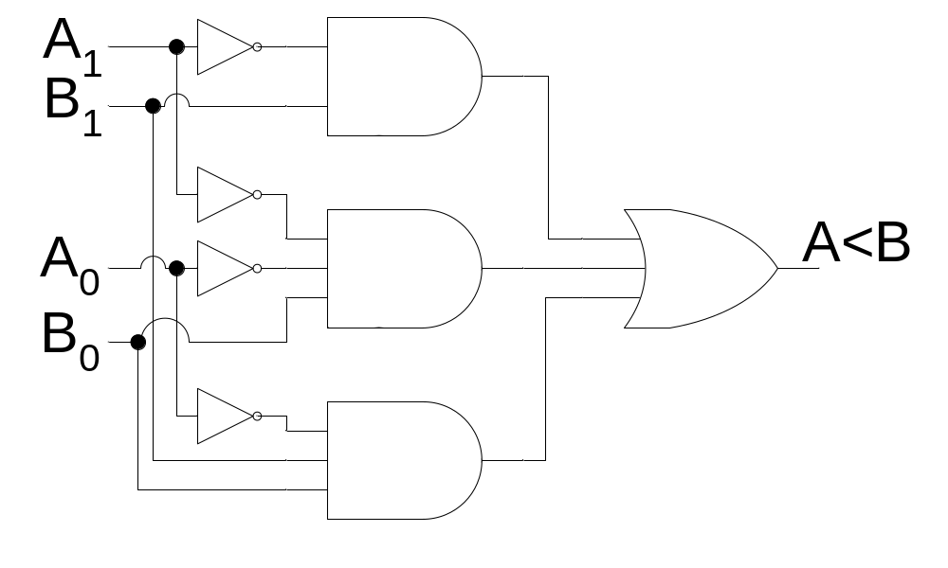
Implementation of A<B

Slide 13
Comparison of numbers by Cascaded 4-bit Comparator
A | B | Comparator M | Comparator L
1101 | 0111 | A>B
0110 | 1011 | A<B
0011 | 0010 | A=B | A>B
0100 | 0101 | A=B | A<B
1001 | 1001 | A=B | A=B

Slide 14
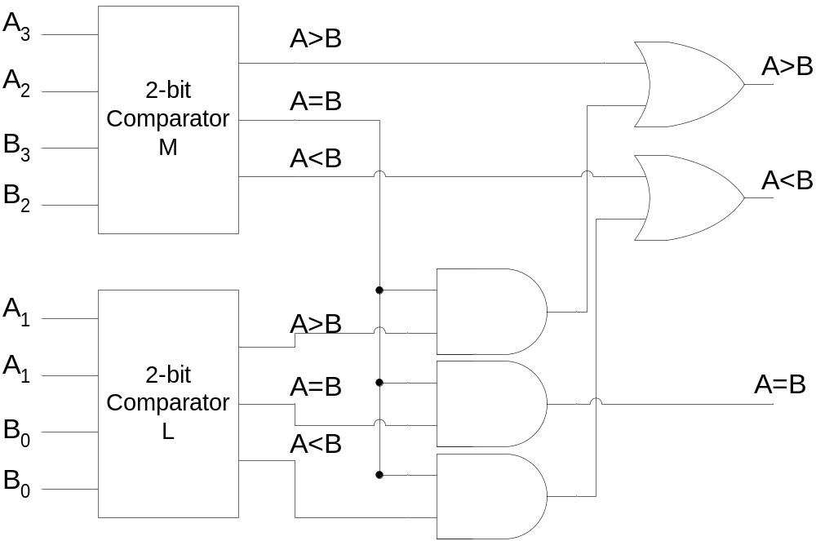
Implementation of 4-bit Comparator by Cascading two 2-bit Comparators

Slide 15
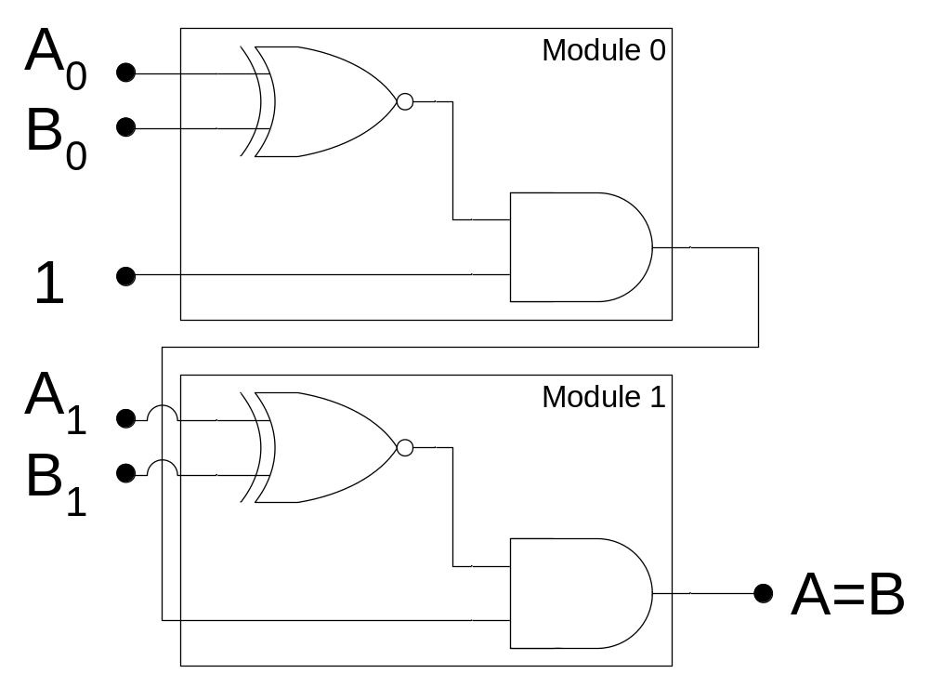
Iterative Circuit Implementation of A=B function

Slide 16
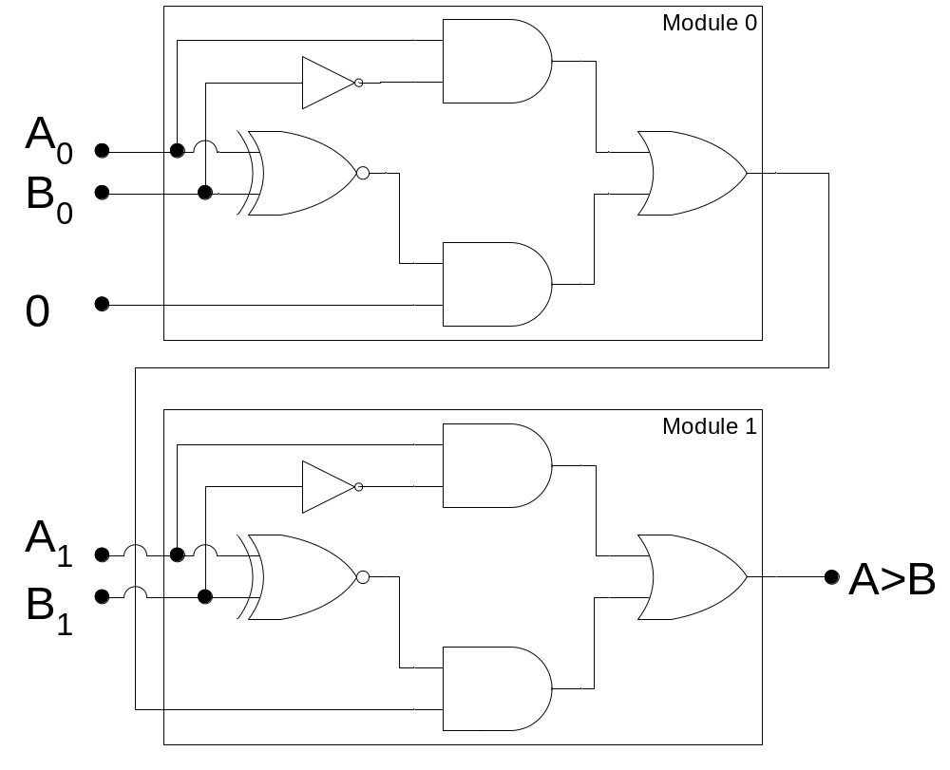
Iterative Circuit Implementation of A>B function

Slide 17

Magnitude Comparator (A==B)

Slide 18
Magnitude Comparator (A<B)

Slide 19
Magnitude Comparator (A>B)

Slide 20
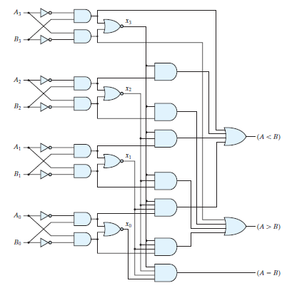
Magnitude Comparator

Slide 21
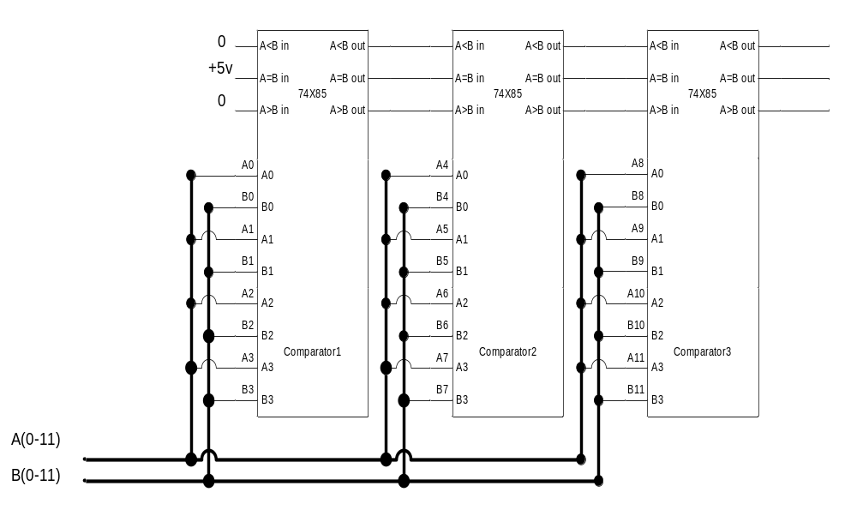
12-bit Comparator

